Slide 1
Miun Innovation
SIMS 2022
Maria Wiik, Bizmaker
Holger Noack, Miun Innovation
Johan Landström, Miun Innovation

Slide 2
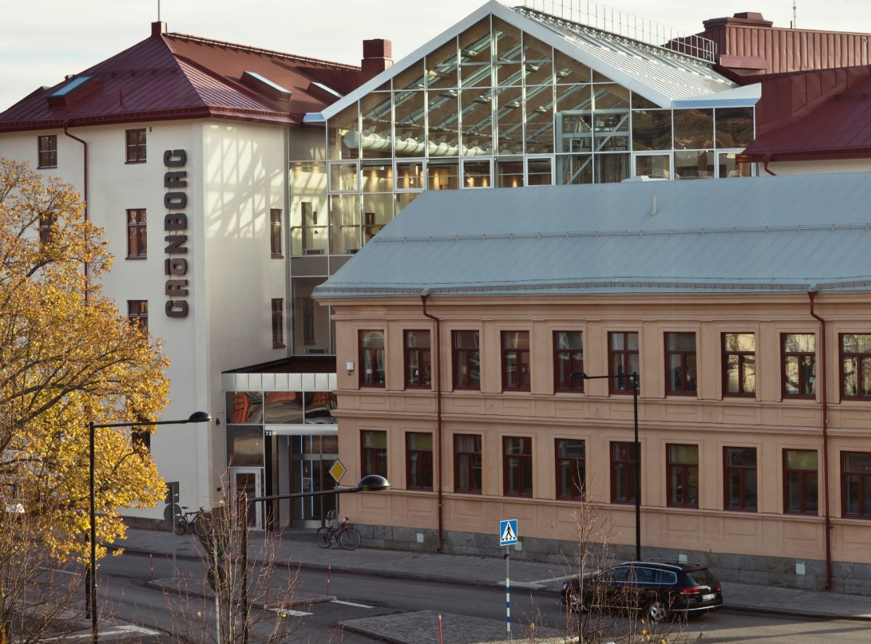
Miun Innovation
Governmental support structure for students, teachers and researchers.
Supporting in:
Innovation
Business start up
Courses

Slide 3

LET’S MAKE A MILLION
MILLION IDEAS POP
We help startups achieve results faster and smarter, offer guidance to companies to develop and grow, challenge public organisations ability to innovate and encourage people with new ideas to move towards entrepreneurship.
SUNDSVALL ÅNGE TIMRÅ HÄRNÖSAND ÖRNSKÖLDSVIK KRAMFORS SOLLEFTEÅ

Slide 4
Course objectives
in cooperation with others identify the need of products and services
present the product in speech and writing

Slide 5
Go to www.menti.com and use the code 5175 8897
Notes:
Två frågor, förväntningar på kursmomentet och vilka målsättningar har du för dig själv i denna kurs (Johan)

Slide 6
Problem capture precedes solution
What impact has the problem, how costly and how urgent?
S – situation, establish current situation
P – understand the problemet, identify discontent
I – Implication, explore causes and effects of the problem, who are affected and in which way, what are the consequenses
N – need of solution, what is the value of a solution, what need would a solution bring to the organisation

Slide 7


Dear mum, can we please get a cat.
I promise to take care of it.
I am sorry, dear child, but this is not a good idea...

Slide 8


NABC method
Developed at Stanford Research Institute
First step in creating a more complete business plan
A tool to define and communicate an idea - using the fundamental ingredients of a value proposition:
“An important client or market need,
addressed by a unique approach,
with compelling benefits when compared
against the competition or alternatives.”

Slide 9


Problem or solution - what comes first?
When constructing sentences, it is easier for the reader to imagine the object before the action
“the cat eats the fish” vs “the fish is eaten by the cat”
Similar, new ideas are easier to convey, if their presentation follows a structure that is brain-friendly
“First we need understand why an idea is needed, before we are able to shift our attention on how it works, and what exactly it offers”
Notes:
If you manage to connect your audience emotionally, then you have their full attention

Slide 10

“I Need lots of Almonds, Berries, and Chocolate” - in that order!
Need Why is it important to solve this need?
Approach How are you going to address the need?
Benefits What are the compelling benefits of your approach?
Competition What are the alternatives?
Notes:
Unique Value Proposition aka Unique Selling Point

Slide 11

Your Unique Value Proposition
A potential client’s specifc need
Your approach w/ compelling benefits
Competing solutions with their benefits
Notes:
Need to be unique

Slide 12


Need - should be specific and relate to an important opportunity
Context of the need
Preconditions for the need to occur, e.g. situational settings / process steps?
Certain demographics, occupations, professions, industries that have this need?
Why is it important to solve it, now?
Size of the need
How many people are affected and how often? How fast is the problem growing?
Estimated market size, geographic distribution?
Impact of the need for the client
Time and cost efficiency, quality of results, missed opportunities
Health, safety, pollution etc.
Notes:
Need should be specific
Important to get it solved - an urgent problem
Can be bottle neck in a process

Slide 13

Approach - the proposed solution to solve the need
Is developed and refined through iterations
Start small with sketches, mockups, paper versions, prototypes
Go out an get feedback as early as possible, adopt and refine
Benefits - of your solution for the client
Specify the main benefits and try to quantify their effect
Account for obstacles that need to be overcome to enable your solution
E.g. process restructuring, exchange of equipment, training of personnel etc.

Slide 14

Competition - everyone has alternatives
Clearly understand the competition and the client’s alternatives
Status quo? - how urgent was it to solve the need?
Temporarily workarounds? - how big of a problem was the need for the client?
Existing solutions with their specific advantages and disadvantages
Completely different approaches that make the need obsolete
...Unique Value Proposition

Slide 15
We have a lot of mice in the kitchen.
One made it into my lunchbox and ate all the cheese.
My dear child, I am so sorry. What can we do?

Slide 16


We either have to catch them all, or try to scare them away.
A cat would be the best solution.
Yes, I agree. What a great idea. A cat it is then!
?

Slide 17

Bonus Material SPIN: Understand a client’s problem
Situation | Problem | Implication | Need-Payoff
Understand the status quo. Look at the whole picture, e.g. business goals, process goals, dependencies,and external factors. | Uncover the problems of your client. Both, the ones they are aware of, and the ones they have not considered yet. | Understand the urgency of solving a particular problem, or part of that problem, from the client’s perspective. | Identify potential benefits of solving a specific problem, and the payoff for taking action now, rather than later.
Ask open-ended questions - avoid implication
Do not dominate the conversation - let the client clarify
Do not rush - give your client time to reflect, you can always ask more later

Slide 18
Bonus Material SPIN: Situation Questions - Examples
Can you tell me about your role at your company?
Can you tell me about your current processes?
Which departments in your company depend on the outcome your work?
What type of imput from other departments do you need to conduct your work?
What is your top priority for the year?
How is your priority important to your business?
What tools do you currently use?
Why are you using these tools instead of …?
How often do you use these?
Who is responsible for…?
Who plans and manages the strategy / budget for…?

Slide 19
Bonus Material SPIN: Problem Questions - Examples
How important is … to your business?
What challenges do experience in your work?
Are there any particular bottlenecks?
How easy is it to make progress towards…?
Why does this approach work / not work for you?
Does your current approach ever fail?
What happens if you are not successful with?
In a perfect world, what you change in your approach?
Do you think … can be solved?
What is stopping you from solving …?

Slide 20
Bonus Material SPIN: Implication Questions - Examples
Has the business ever missed a performance indicator due to the current approach?
What is the cost of the current approach?
How much time does your approach require?
How would you distribute resources differently if you did not need to use them for…?
What goal would you like to achieve that you currently can’t because of..
How is this … impacting your teams work?
How is this … impacting your customer’s experience?
Would resolving this….allow you to improve … (efficiency, cost, quality)?

Slide 21
Bonus Material SPIN: Need-Payoff Questions - Examples
What would change if you did … differently?
How would it be easier to achieve … with [suggested solution] ?
Would your team get value from…?
How would your company benefit from [suggested solution] ?
How exactly would solving … help you?
What would achieving ... mean for your business?
How much time do you have to solve … ?

Slide 22


Slide 23

Develop a 1,5 min pitch based on SPIN and NABC
Use your company contact!
Notes:
Johan skriver fram en instruktion för arbetet i grupperna samt gör redovisningsindelning
De jobbar i sina grupprum och vi går runt
Knowit: L522
Bolagsverket: L522
Technicus: Tvätteriet
Höga kusten teknikresurs: Tvätteriet
Atea: L522
SPV: Miun Innovation
DIGG: L207/L209
Knightec: L207/L209 MIUN: S241

Slide 24
Time slots for tutoring sessions
7th Sep
13:15 Knowit
13:55 Bolagsverket
14:35 Technichus
15:15 Höga Kusten Teknikresurs
15:55 Atea
13th Sep
13:15 SPV
13:55 DIGG
14:35 Knightec
15:15 MIUN
All tutoring session will take place at Grönborg, main entrance, first door to the right named ”Bizmaker”.

